Slide 1
Loops

Slide 2
Let’s Review What We Did Yesterday
Code Structure - Sequence, Selection, Repetition. The way the computer processes code
Booleans - Data type that returns either True or False
Comparison Operators - <, ==, !=, >= Compare things and return a boolean value
Conditional Statements - Run code if conditions are made. We learned about…
If Statements - If condition is true, run code. Else, skip

Slide 3

Control flow
How the computer makes decisions.
The order in which the code is executed.
Sequence
Selection
Repetition
CODE
Notes:
It controls the way the code is executed.

Slide 4
Flow Control - Repetition (Loops)
Iteration - Do it again
Should we type out hundreds of lines of code for each element? No! This is where a for loop comes in
A for loop loops through an iterable – which is a collection of things that we can sort through one at a time (like a list, string, array, or dictionary) – and performs the same action for each element in the iterable
Used to repeat the same code over and over.
FOR Loop - loops iterate over a given sequence
WHILE Loop - repeat as long as a certain boolean condition is met
Will not stop until the condition is met or the sequence ends

Slide 5
For Loops
Count-Controlled loop
Iterates over elements of a sequence until the sequence ends/the number of iterations is reached
Used when you have a block of code you want to repeat a fixed number of times
Sequence end?
True
False
Statements
EXIT

Slide 6
For Loops: Syntax
for variable in [val1, val2, etc.]:
statement(s)
Notes:
The indent is very important because everything after the indent is in the loop!

Slide 7
For loop example
Loop only runs 3 times because there are 3 elements
Stops once there are no more elements in the list

Slide 8
DEMO - In Python tutor
list_of_prices = [12, 62, 49, 22, 31]
for clothing_item in list_of_prices:
clothing_item = clothing_item * .5
print("The new price is ", clothing_item)

Slide 9
Range functions in for loops
range ( )
Range functions can produce an integer sequence at runtime.
You can tell the computer to do something specifically for a certain range of numbers that you choose.

Slide 10
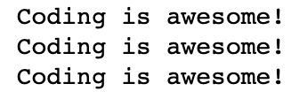


Examples - Range
for i in range(3):
print(“Coding is awesome!”)
for i in range(1, 7):
print(i)
for i in range(2, 20, 3):
print(i)
Range starts at zero if not specified, and the step size is one if not specified.

Slide 11
For Loop with Conditional Statements
fruits = [“apple”, “banana”, “cherry”, “kiwi”]
for x in fruits:
if “a” in x:
print(x, “⭐”)
elif “i” in x:
print(x, “❤️“)
else:
print(x, “😃”)
WHAT PRINTS FOR EACH LIST ITEM?

Slide 12
In notebook 04_Loops, complete the following section:
1 - For Loops
Notes:
Stop/Start here!

Slide 13
While Loops
Made up of a condition or expression followed by block of code to run.
Evaluated in a Boolean context (TRUE or FALSE)
Condition
False
True
Statements
EXIT

Slide 14
While Loops: Syntax
while condition:
statement(s)

Slide 15
While loop example
Loop runs 5 times because there are only 5 times this condition is true
Stops once condition is no longer met

Slide 16
While loop demo
budget = 100
cost_of_items = 0
while budget != 0:
cost_of_items += 10
budget -= 10
+= means you add that number to the total
-= means you subtract that number from the total

Slide 17
The infinite loop
A loop becomes infinite if a condition never becomes FALSE.
For loops repeat a specified number of times so they are definite
While loops can become infinite

Slide 18
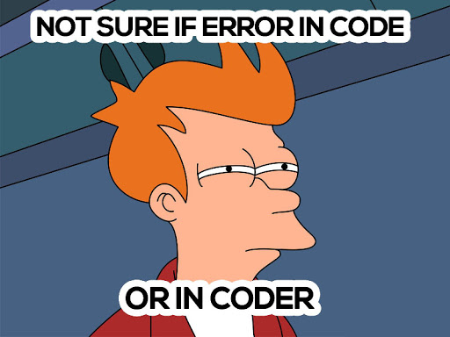
Infinite loop examples
a = 0
while a < 10:
print(a)
a = a / 2
while 1 == 1:
print(“What is wrong with this loop?”)

Slide 19
In notebook 04_Loops, complete the following section:
2 - While Loops

Slide 20
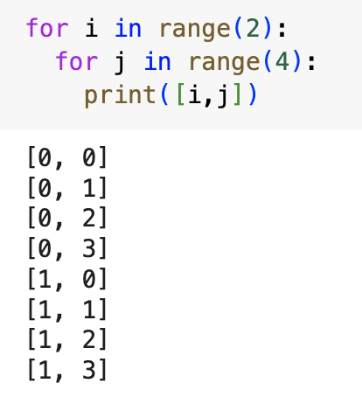
Nested Loops
A nested loop is when you have one loop inside of another loop
Also used when you want to repeat the same code multiple times but you would want to use a nested loop when you want to get all combinations of two iterables such as two lists
Important!! The inside loop iterates fully for the assigned variable in your outside loop before moving on to the next variable in your outside loop

Slide 21
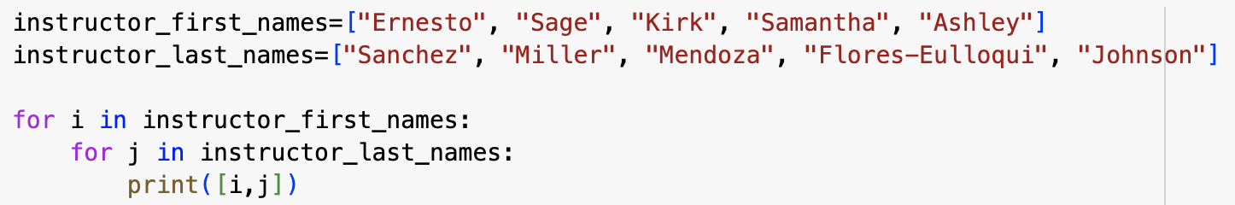
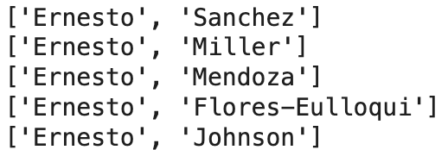
Nested Loop Examples
Let’s say I wanted to get all combinations of the instructors’ first and last names. This would be a perfect example of when to use a nested loop.
The first 4 items printed would be
You can see that the first variable i is assigned to Ernesto since that is the first element in the instructors_first_names list but that the inside loop iterates over every possible last name for that first variable in the first list, “Ernesto”

Slide 22
Nested Loop Example Continued
What do you think the whole printed statement would be if I ran the code?

Slide 23
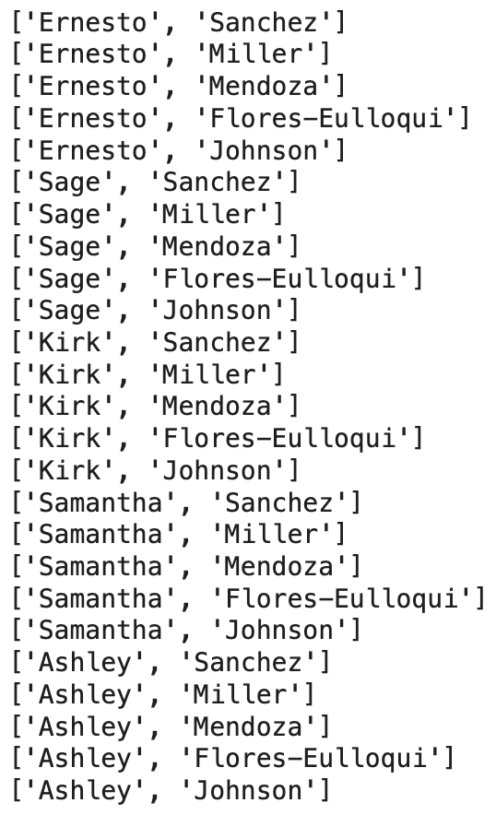
Nested Loop Example Continued
What do you think the whole printed statement would be if I ran the code?

Slide 24
In notebook 04_Loops, complete the following section:
3 - Nested Loops
If you finish early complete the bonus section on List Comprehensions.
When you are done, complete the Exit Ticket!

Slide 25
List Comprehensions
You can think of simple list comprehensions like a Data Science pie that contains 2-3 different “flavors”
These “flavors” consists of Data Science essentials that we have learned so far: lists, for loops, and (sometimes) conditional statements
All of these “flavors” are combined in order to help us create lists in a concise manner
List comprehensions are often used when you want to make a new list by applying some operation to every element in an already existing iterable (see the connection to the for loop), and when you want to create a list where the elements meet a certain condition
Loops
Lists
Conditionals
The List Comprehension Pie

Slide 26
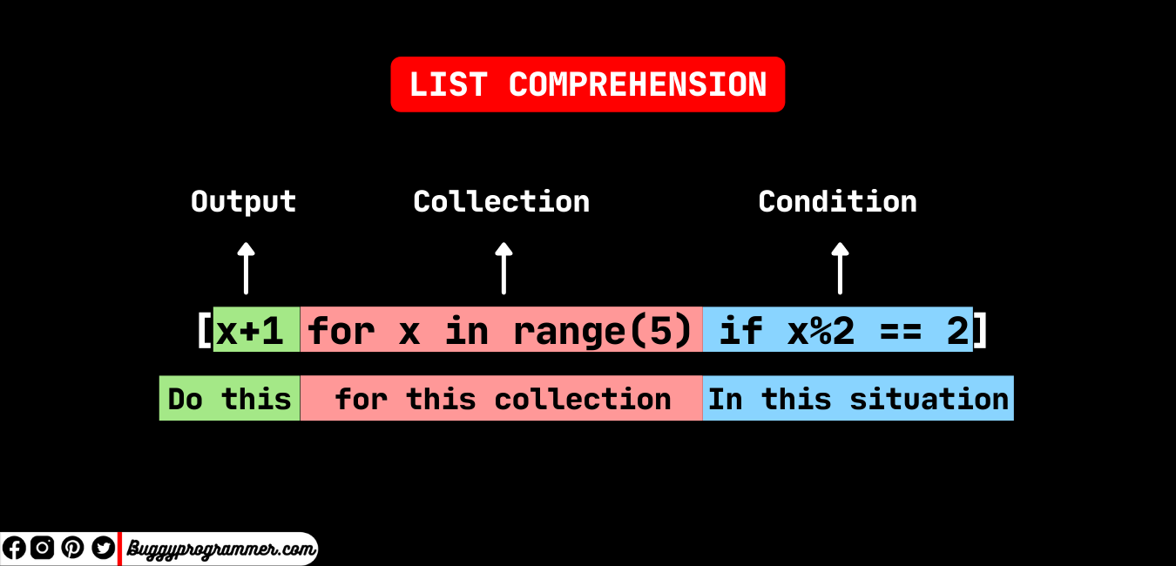
image credit

Slide 27
List Comprehension Examples
vegetables = [“broccoli”, “carrot”, “spinach”, “radish”]
Let’s say I wanted a list of vegetables but only the vegetables that have the letter “i” in it.
You can accomplish this with just one line of code.
While I could do:
i_vegetables= []
for veggie in vegetables:
if “i” in veggie:
i_vegetables.append(veggie)
print(i_vegetables)
I could also do:
i_veggies=[veggie for veggie in vegetables if “i” in veggie]
print(i_veggies)

Slide 28
More List Comprehension Examples
I can also manipulate the elements that are in my list or in a sequence using list comprehensions.
Let’s say I want a list of the cubed values of the integers 0-20
While I could do:
cubed_values=[]
for x in range(21):
x=x**3
cubed_values.append(x)
print(cubed_values)
I could also achieve the same output in one line of code:
cubed_list=[x**3 for x in range(21)]
print(cubed_list)

